Slide 1

Predicting Customer Churn Via Classification
CS542 Machine Learning Project
Team 9:
Ding Ma, Henry Zhong, Yifan Zhang, Jiaru Li
Boston University
June 30th, 2021

Slide 2



The Challenge
Telecommunication companies face two problems when it comes to maximizing the number of users in their networks:
Attract new customers and retain existing ones.
Given that it is typically more costly for a business to attract new customers than retain existing ones, is there a way for a business to predict whether an existing customer is going to leave?

Slide 3


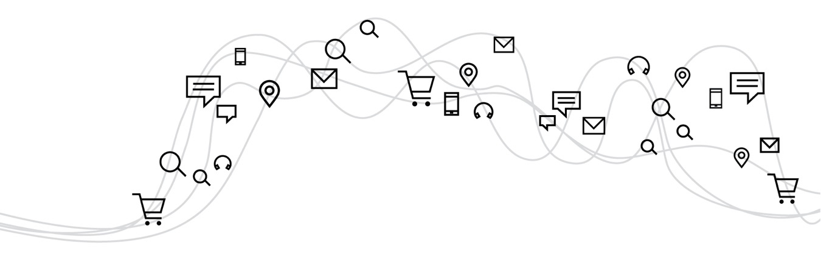
Project Objectives
Build a machine learning model that leverages a plethora of data types to predict churn - whether an existing customer leaves the service provider.
Optimize the model to take into account the relative cost of false positives and false negatives to a telecommunication business.
‹#›

Slide 4

Methodology
Prior to building the model, the data set was cleaned and prepared to remove potential bias. After the initial build, L2 penalization, oversampling and undersampling, and decreasing threshold techniques were tested to improve the accuracy of the model.
Data Set Preparation
Logistic Regression
L2 Penalization
Over and Undersampling
Decreasing Threshold

Slide 5
Data Set Analysis and Preparation

Slide 6












Data Features
The 5986 sample data set contains 19 features and 1 label (whether there was churn) from an anonymous telecommunication company. The data set is publicly available via kaggle.com.
The features include a wide range of metrics, such as demographic characteristics, the services they use, the duration of using the operator's services, the method of payment, and the amount of payment, etc.
Streaming
Movies
Demographics
Monthly Charge
Tech Support
Phone Service
Device
Protection
Online
Security
Internet
Service
Payment Method
Streaming TV

Slide 7
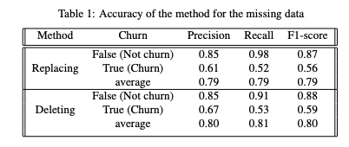
Missing Data
After factorizing categorical data and converting string-format real value to float format, we found that 10 users have missing data. To minimize the influence of missing data, we tried two methods:
First one is replacing missing data with mean, and second one is deleting all the missing values:
Just deleting the users with missing data yielded higher accuracy

Slide 8
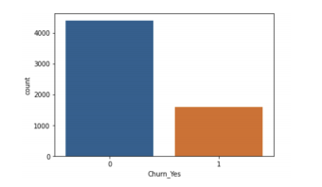
Imbalanced Data
There are far more customers that did not churn versus those who did. This may cause the model to be better at classifying customers who are not at risk of churn, versus those who are at risk. This will be addressed in the oversampling and undersampling techniques employed in our analysis.

Slide 9
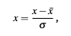
Data Normalization
Since the dataset is composed of a wide range of values, it needs to be normalized before the model can be trained. The following normalization function was used for all features:
Where ¯x is the mean and σ is the standard deviation.

Slide 10
Model Testing

Slide 11
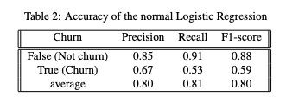
Logistic Regression
A first run of the logistic regression model on the normalized data yielded the following results:
While the overall accuracy for recall and precision are .81 and .80, respectively, the accuracy for detecting true churn is lower than 0.6.
For telecom companies, it is important to accurately predict true churn, therefore we need to specifically increase the recall accuracy for true churn
High precision means low false positives
High recall means low false negatives
F1-score is the harmonic mean of precision and recall

Slide 12
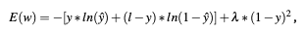
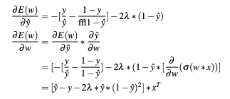
L2 Penalization Implementation
Adding an L2 penalization on the target class so that the model classifies more 1s (churn) than 0s, in order to increase the recall of classifying 1.
The error function with L2 penalization is:
where λ represents the penalty.
Using this error function, we derive a new back propagation
equation with weights and bias as:

Slide 13
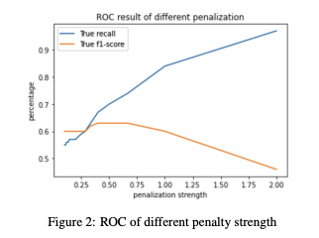
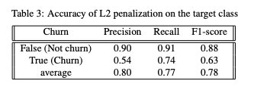
L2 Penalization Results
After applying the back propagation formula, we get the following chart that tracks how f1-score changes with different values of λ :
Implementing the penalty value of 0.666 yields the following model accuracy, which has improved true recall:
The penalty value that maximizes f1-score is 0.666

Slide 14
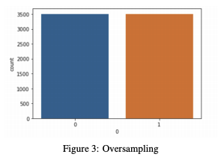
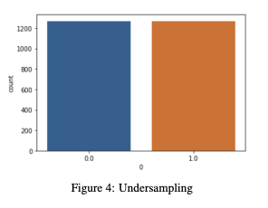
Oversampling and Undersampling Implementation
Oversampling is achieved by repeatedly sampling the minority class via SMOTE, Synthetic Minority Oversampling Techniques, which reduces overfitting by synthesizing new samples with fewer categories through k-nearest neighbors.
Undersampling is achieved by first randomly deleting samples from the majority class then train the model, then repeat the above multiple times. Then, use voting among the models to determine the final prediction.

Slide 15
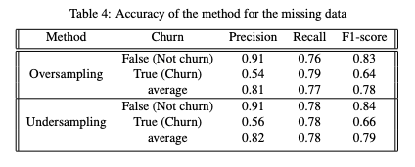
Oversampling and Undersampling Results
By either oversampling or undersampling, the accuracy of true recall is increased at the expense of false recall.
This is desirable, since it may be more costly for telecom companies to lose customers due to not identifying customers who will churn (false negative) than misidentifying customers as going to churn when they were not (false positive)
Oversampling and undersampling yields the following results:

Slide 16
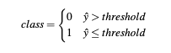
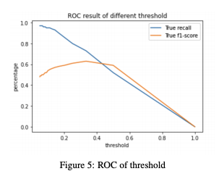
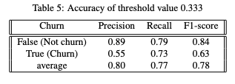
Decreasing Threshold Implementation and Results
Another way of minimizing the bias from the imbalanced data is simply changing the threshold when predicting using the output of the ordinary logistic regression.
The threshold that maximizes f1-score is 0.333
Maximum f1-score also achieves a balanced recall accuracy between true churn and false churn:

Slide 17
Conclusion

Slide 18
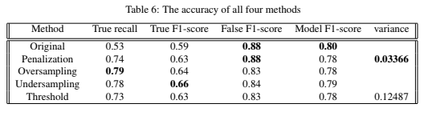
Model Comparison
Oversampling is best if we only care about minimizing false negatives when looking for true churn
Undersampling is best if we care about minimizing both false negatives and false positive for true churn
Penalization is best if want to increase model accuracy for true churn without lowering the accuracy for false churn
Notes:
[DEMAND CLOSING SLIDE]
To review, we connect advertisers with more quality customers, backed by trust and performance that allows you to:
Stand out online and break through the clutter, backed by the #1 professionally generated content provider
Reach nearly 900M users monthly with trusted data to pinpoint exactly who you want to target
Drive more results and better performance with the #1 DSP, SSP, from Ad Week

Slide 19

Key Takeaways
1 | 2 | 3
80% prediction accuracy was achieved via logistic regression After cleaning and normalizing the dataset a logistic regression model was able to produce an overall accuracy of 80%. However, this results in higher accuracy for predicting no churn, but lower accuracy for churn, which is what telecom companies care the most. | Oversampling and Undersampling can be useful in increasing recall of true churn A model with oversampling will maximize the recall of true churn, at the expense of lowering precision of true churn, while undersampling will try to maximize both recall and precision of true churn. Both oversampling and undersampling lowers the accuracy of predicting false churn. | Penalization can be used to increase prediction accuracy for true churn without lower accuracy for false churn Compared to oversampling and undersampling, penalization will not increase true churn accuracy as much, but will also not lower false churn prediction accuracy compared to the original model.
Notes:
In summary, we come away with the 3 key takeaways.

